Slide 1
A Case Study in Beer
by Ben Goodwin & Justin Ehly

Slide 2
Analysis Questions
How many breweries are present in each state?
Why are there missing values?
What is the median ABV and IBU for each state?
Which state(s) has the highest ABV and which state(s) has the highest IBU values?
Provide summary statistics and distribution of ABV.
Is there a relationship between the bitterness of the beer and its alcoholic content?
Can we use KNN classification to classify certain beers based on “related beers”?
Can we extend this idea to a Bayesian classifier?
We will examine another relationship present in the data.

Slide 3
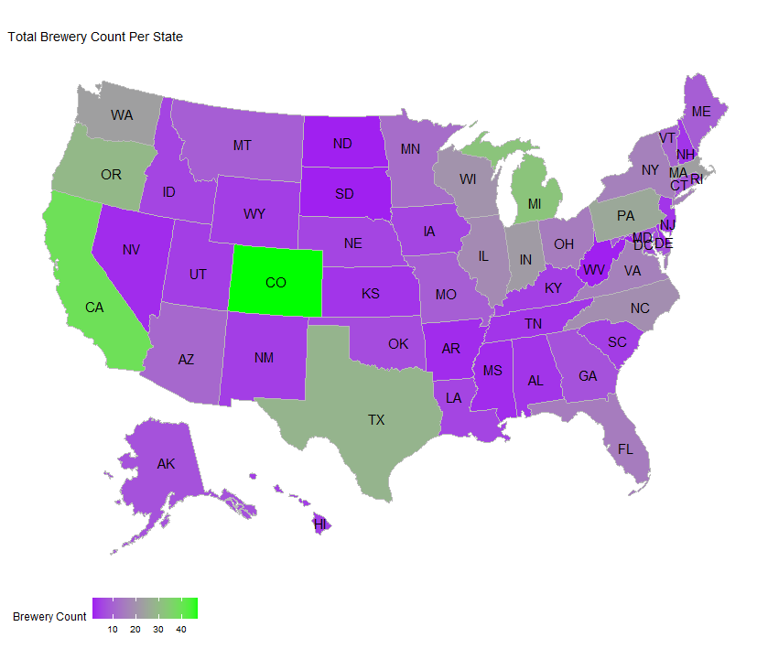
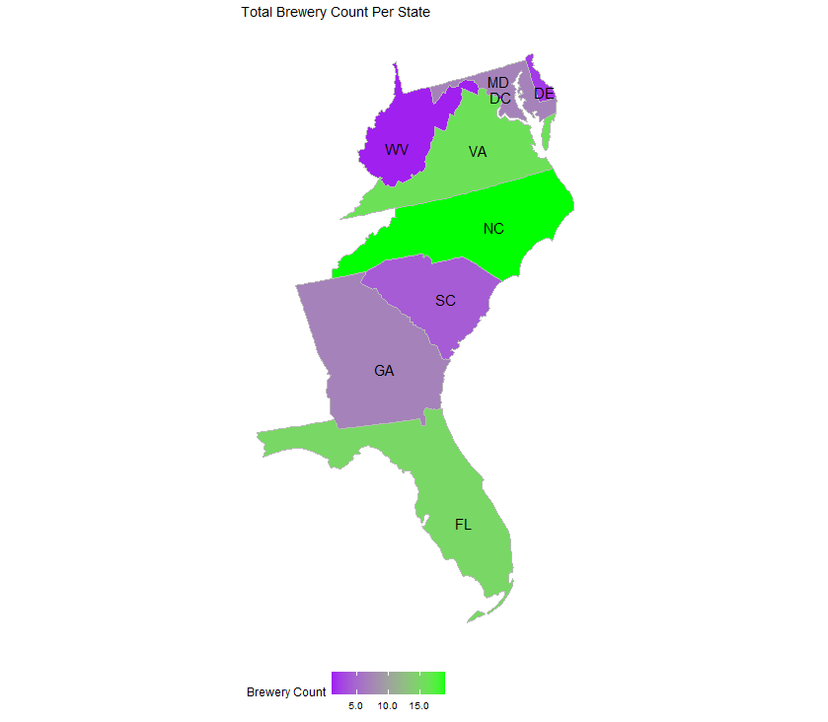
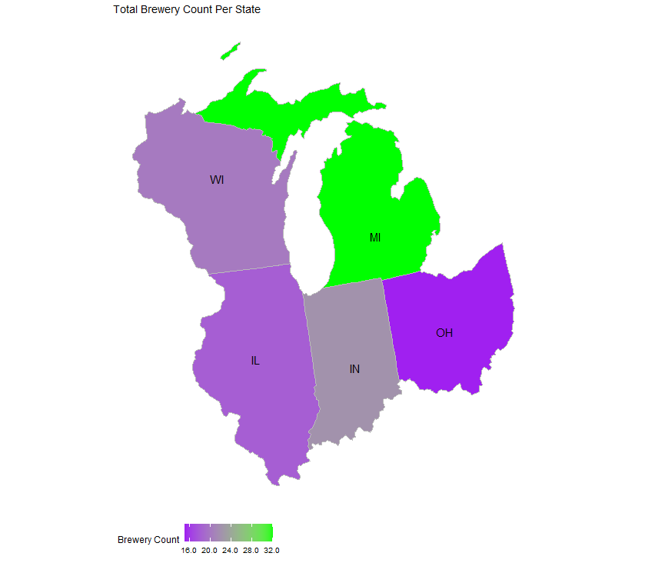
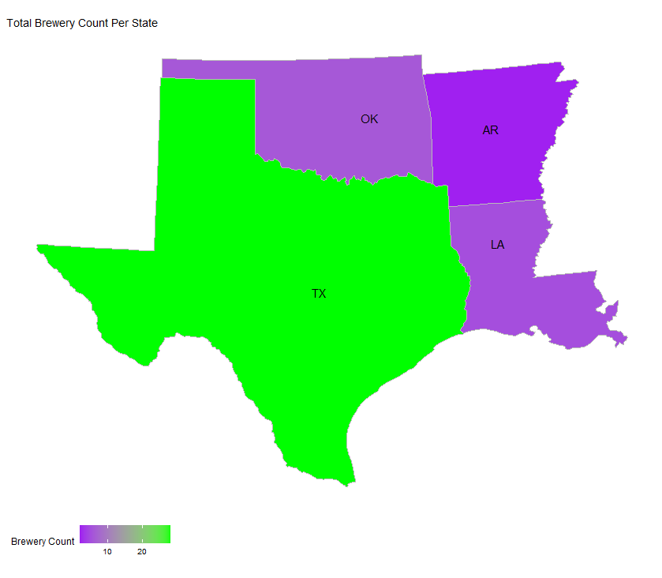
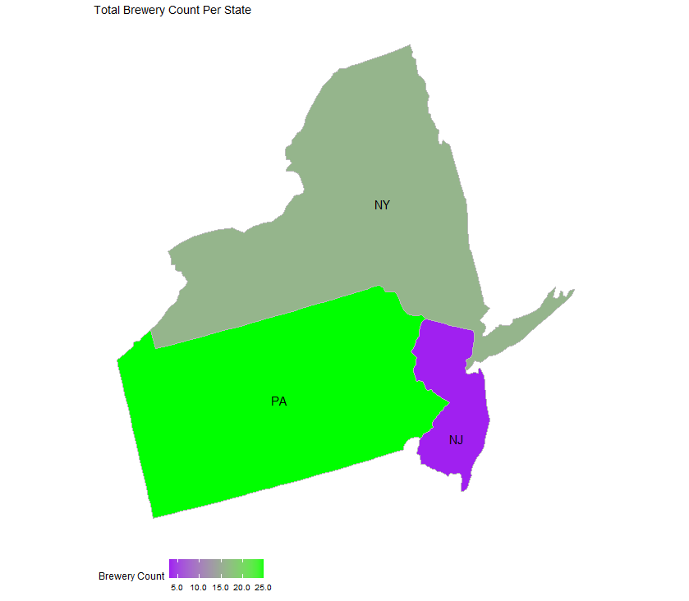
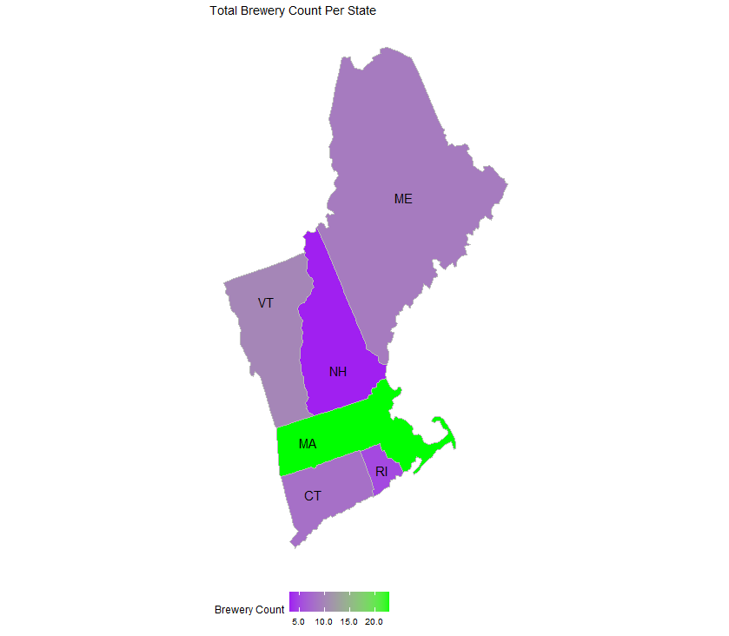
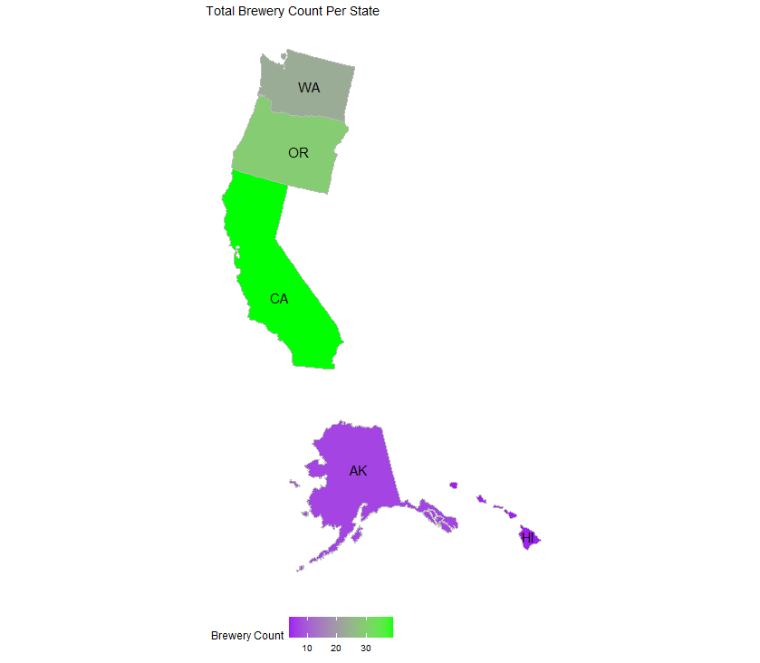
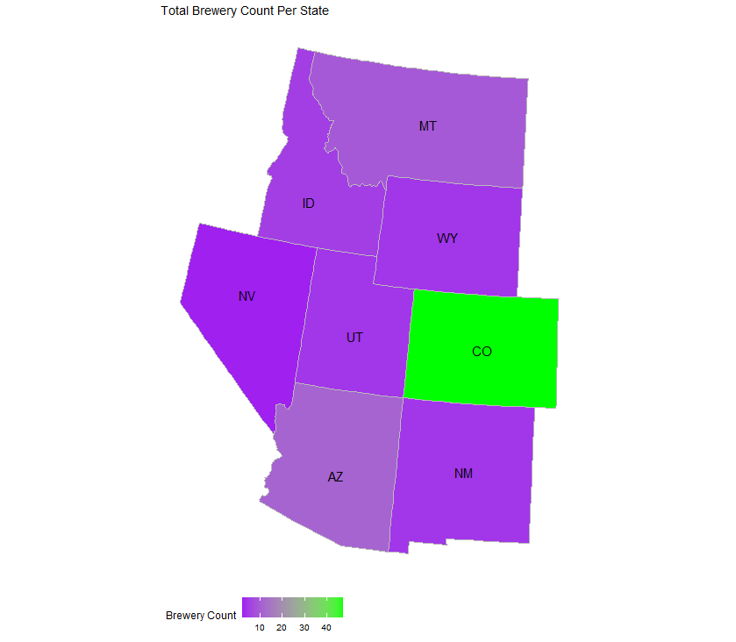
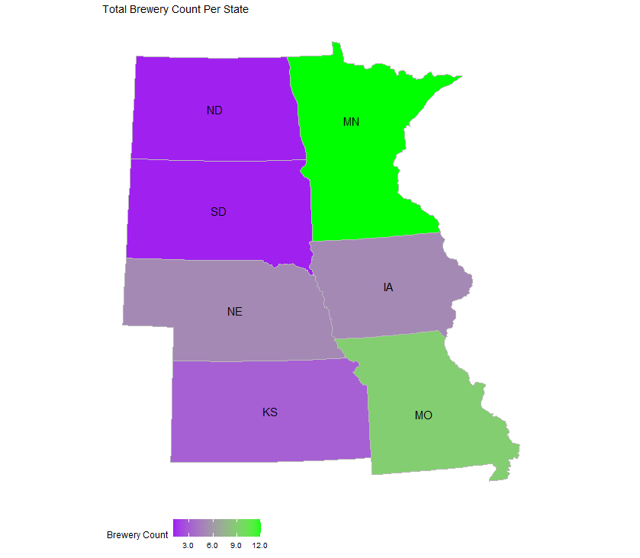
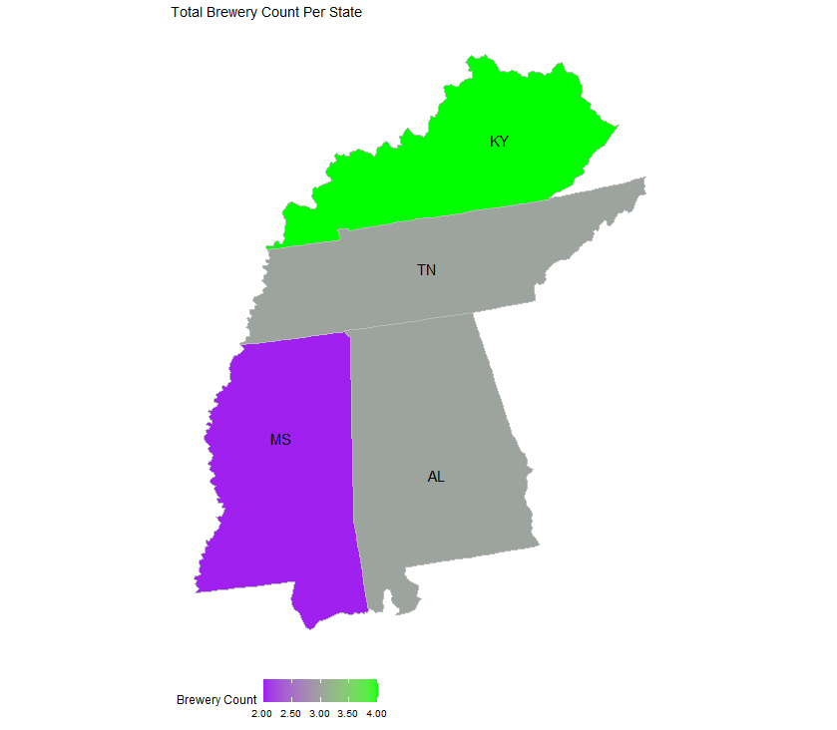
Breweries by State

Slide 4
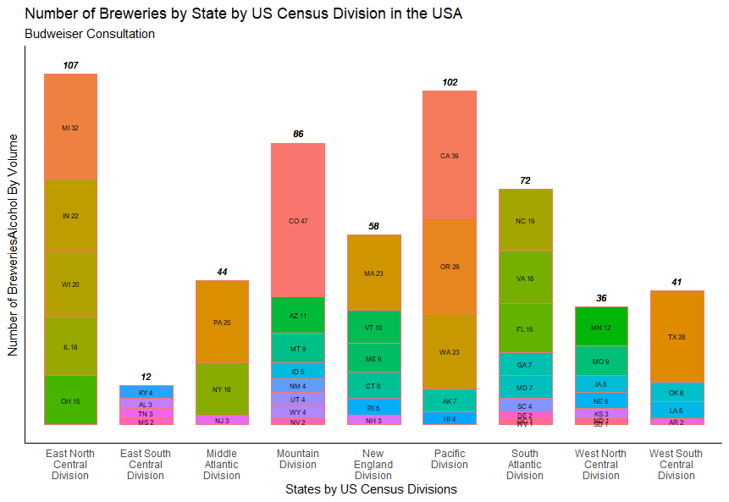
Breweries by State
Top 10 States by Brewery
Colorado -- 47
California – 39
Michigan -- 32
Oregon -- 29
Texas -- 28
Pennsylvania -- 25
Washington -- 23
Massachusetts -- 23
Indiana -- 22
Wisconsin -- 20

Slide 5
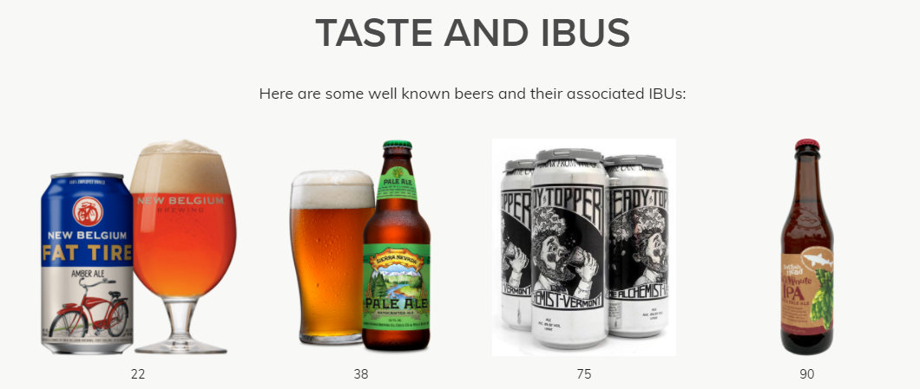
Missing Values
Our approach to handling missing data
Large amounts of dataset missing key IBU and ABV data
Not including these data would reduce power of such a large dataset
100 different styles of beer are present in the data
This provides opportunity to estimate style parameters for missing beers
Strategy
Find mean ABV and IBU for each beer style
Insert this new value in for each NA according to beer style
Due to large sample sizes of each style, statistical inference takes role here in closely estimating parameter values
A/B testing employed to determine validity of data
Estimated IBU and ABV for style has high accuracy when checking against true parameters for missing beers
Photo Credit: https://www.thebrewenthusiast.com/ibus
Notes:
IBU
Smaller breweries cannot afford the equipment to measure IBU and therefore do not use it.
Large breweries can afford the necessary equipment to measure IBU, but tend to use the IBU scale for quality control
isn’t necessarily a true measure of bitterness taste, rather it is a measure of the chemicals in the beer that make it taste bitter (confounding variables can alter this measure though so a lower scoring IBU may taste more bitter than a higher scoring IBU – thebewenthusiast.com for example sites strong Amber ales having IBUs in the 60s that taste less bitter than Pale Ales with mid-50s IBUs
ABV
was actually illegal until 1995 when Coors sued to have it included in its packaging.
mixed and aged beers don’t know ABV until the time the beer is packaged, then it may or may not be stamped onto the bottom of the can, but not necessarily reported.

Slide 6
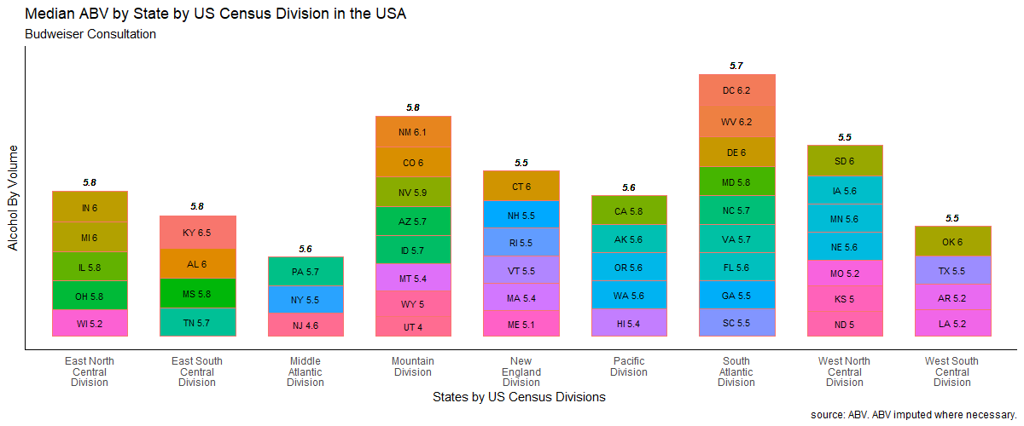
Median ABV by State
Median ABV for All States
5.6%

Slide 7
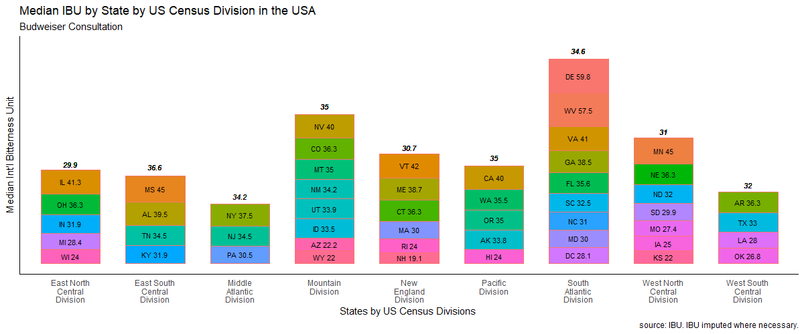
Median IBU by State
Median IBU for All States
33.9

Slide 8
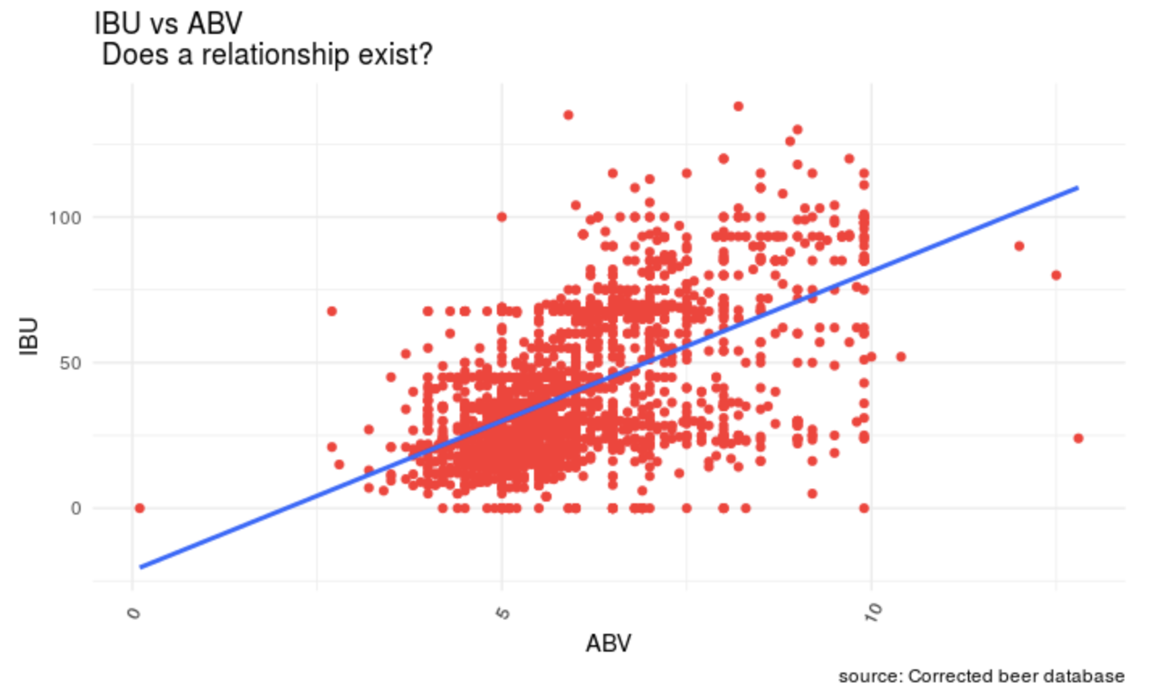
Median ABV vs Median IBU – Does a relationship exist
Visually positive relationship between IBU vs AVB across all beers
Overall median IBU = 33.9
Overall median ABV = 5.6%
What does this relationship tell us?
IBU can be used to interpolate and estimate ABV of a given beer solely based on IBU.
We can develop a model and make predictions based on historical IBU and ABV data
Example, predicted ABV of a beer with 32 IBU
Predicted ABV of 5.72% (97.5% CI: 3.24,8.21)
Note:
West Virginia: ABV is 0.05% - 12.0% ABV for all malt based beverages (SOURCE:https://en.wikipedia.org/wiki/Alcohol_laws_of_West_VirginiaRaising_the_ABV%_Cap)
Utah: Max ABV is 4%, or 3.2 percent by weight for beer. (SOURCE: https://utah.com/state-liquor-laws:~:text=The%20maximum%20alcohol%20content%20is,state%20liquor%20stores%20throughout%20Utah.)

Slide 9
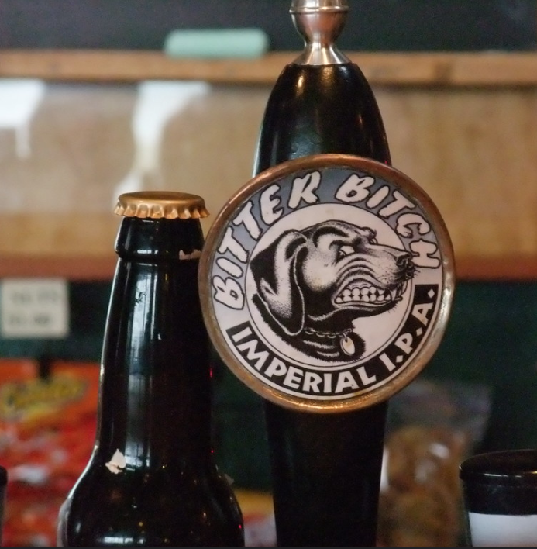
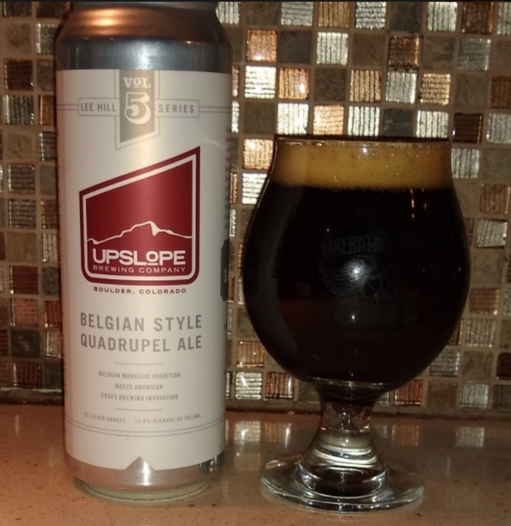
States With Highest ABV and IBU
State with Highest IBU
The Max observed IBU was 138 in Oregon for Bitter Bitch Imperial IPA that is an American Double/ Imperial IPA from the Astoria Brewing Company in Austoria, OR.
State with the Highest ABV
The Max observed ABV was 12.8 % in Colorado for Lee Hill Series Vol. 5 – Belgian Style Quadrupel Ale from Upslope Brewing Company in Boulder, CO.

Slide 10
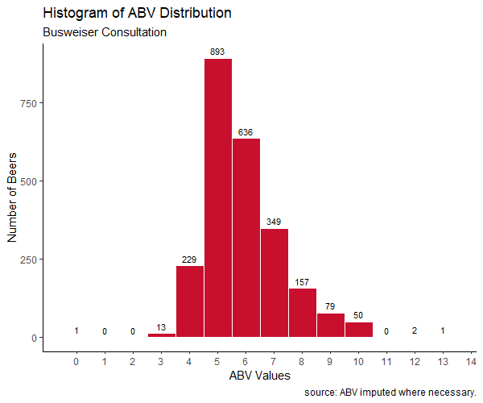
Summary Statics of ABV
All beers have AVB: 0.10 - 12.80
25% have AVB below 5.0
Middle value for all beers: 5.65
50% of beers have an AVB = 5.0 - 6.7
For Example:
Bud Ice (5.5%)
Bud Light Platinum (6%)
Natural Ice (5.9%)
Bud Ice (5.5%)
Budweiser (5%)
Blue Moon (5%)
Stella Artois (5%)
Heineken (5%)
Pabst Blue Ribbon (4.74%)
Miller Genuine Draft (4.6%)
25% have AVB above 6.7
50% have AVB
between 5.0 and 6.7
25% have
AVB above 6.7
25% have AVB above 6.7
SOURCE: https://worldfood.guide/list/list_of_beers_in_america_by_alcohol_content_abv/

Slide 11
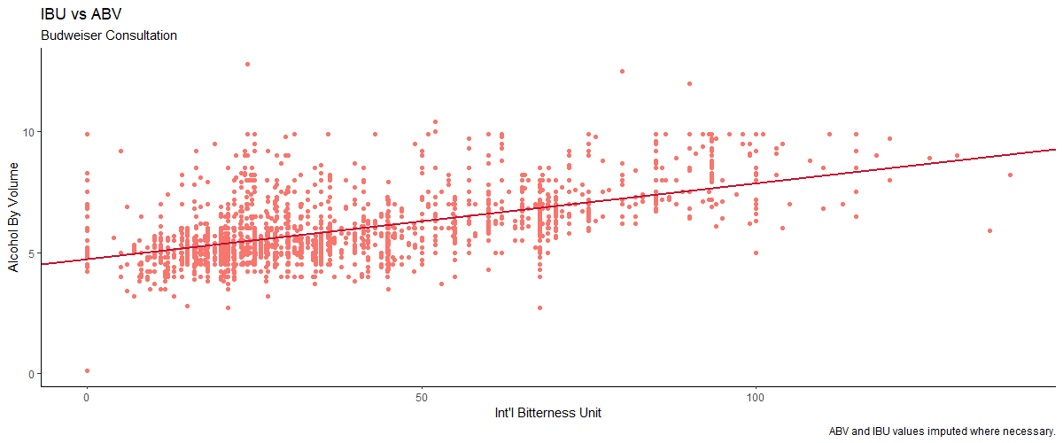
Relationship between IBU and ABV
There is visual evidence of a positive relationship between the IBU and ABV of beer in the USA.

Slide 12
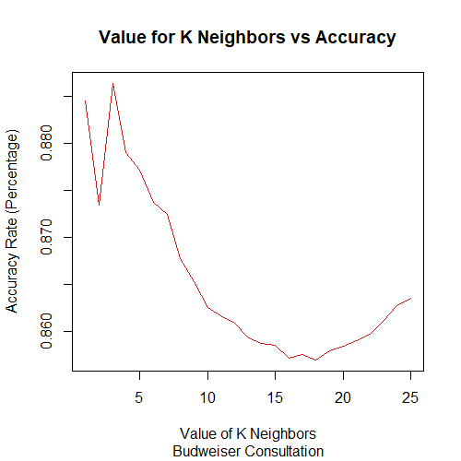
Investigate the Difference between IPA and Ale’s using a kNN classifier
Using KNN (k nearest neighbors)
Determine optimal number of neighbors to best accuracy at predicting beer of IPA or Ale
Reduces dataset from 2,410 to 945 beers
Graph to right shows about 3 neighbors is appropriate
87% accuracy using 3 of the closest beers
Independently
 | Ale | IPA
Correct | 90% | 83%
Not Correct | 10% | 17%

Slide 13
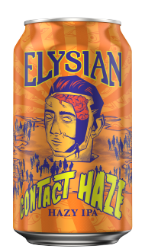
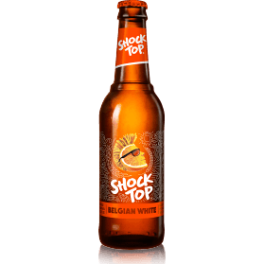
Investigate the Difference between IPA and Ale’s using a Naïve Bayes classifier
Using Naïve Bayes Classifier to compare to kNN
Saw overall 87% accuracy in classifying beers correctly
Very similar performance between Ales and IPAs
 | Ale | IPA
Correct | 90% | 83%
Not Correct | 10% | 17%
OR

Slide 14
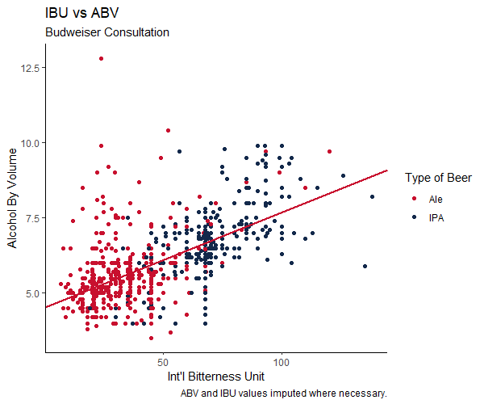
Investigate the Difference between IPA and Ale’s using a kNN classifier
Ale and IPA have some overlap on a chart
 | ABV |  |  | IBU
 | Min | Median | Max | Min | Median | Max
Ale | 3.5 | 5.4 | 12.8 | 7 | 31 | 120
IPA | 4 | 6.7 | 9.9 | 19 | 67.6 | 138
Graph shows how little the overlap between IPA’s and Ale’s there actually is

Slide 15
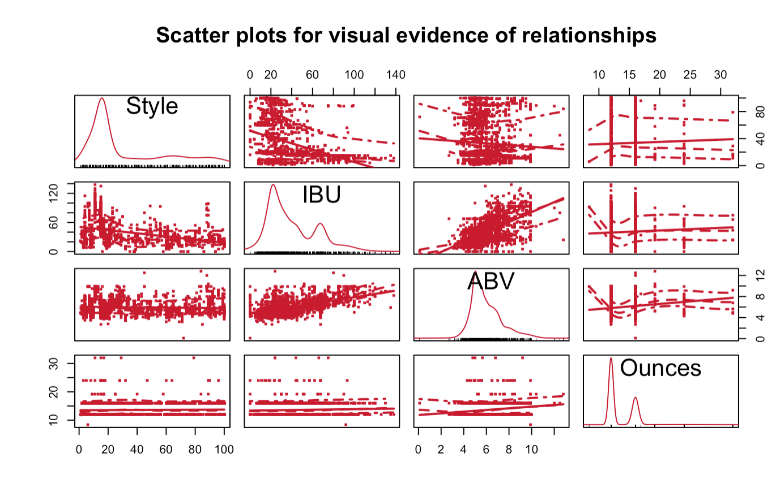
Investigating Relationship Between Style and IBU
Initial EDA for evidence of relationships
Visual evidence of a relationship between IBU and Style

Slide 16
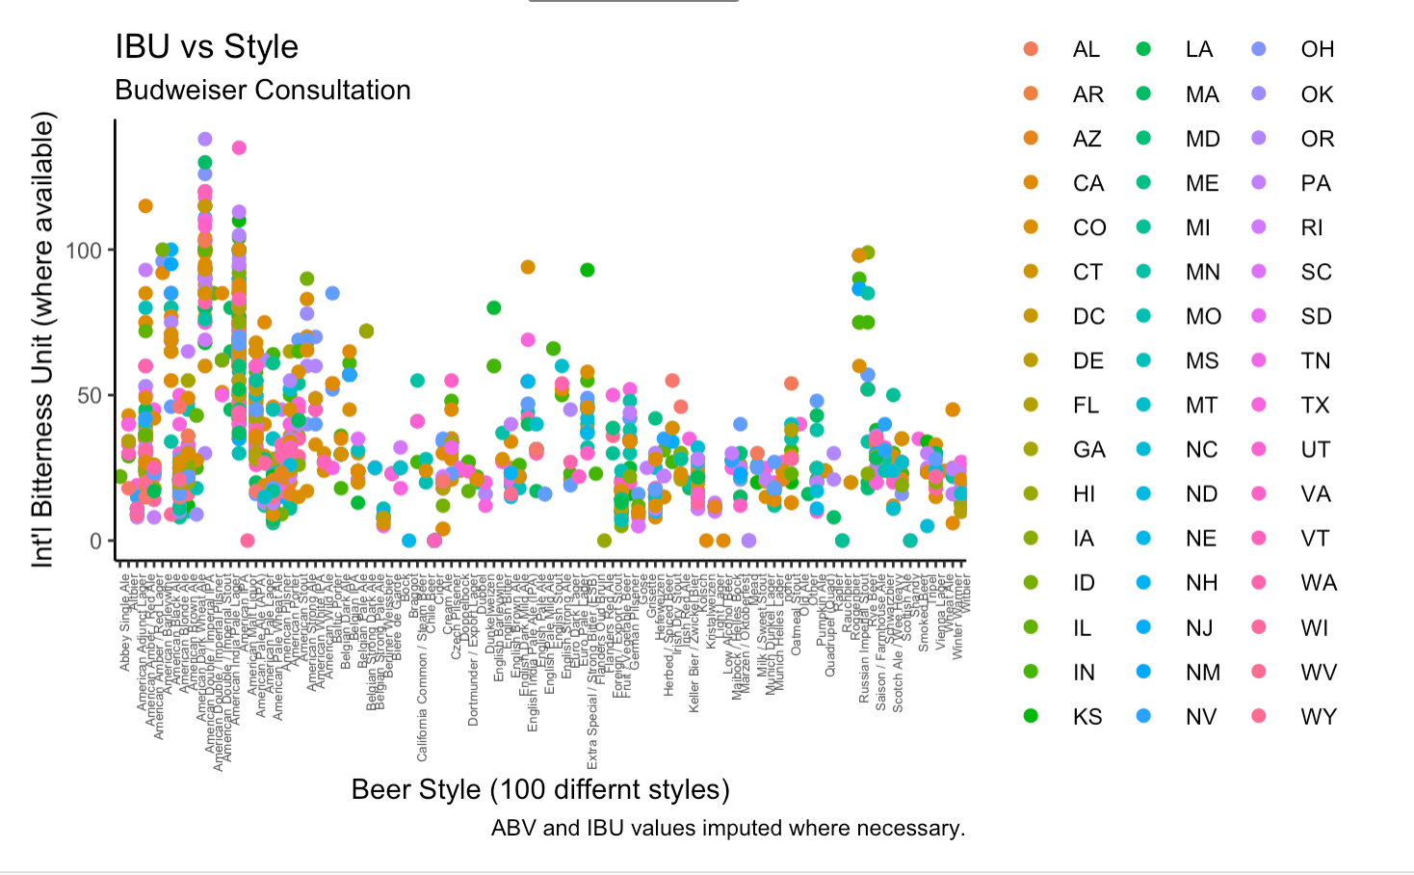
Investigating Relationship Between Style and IBU
Upon further investigation, there is an association between style and IBU

Slide 17
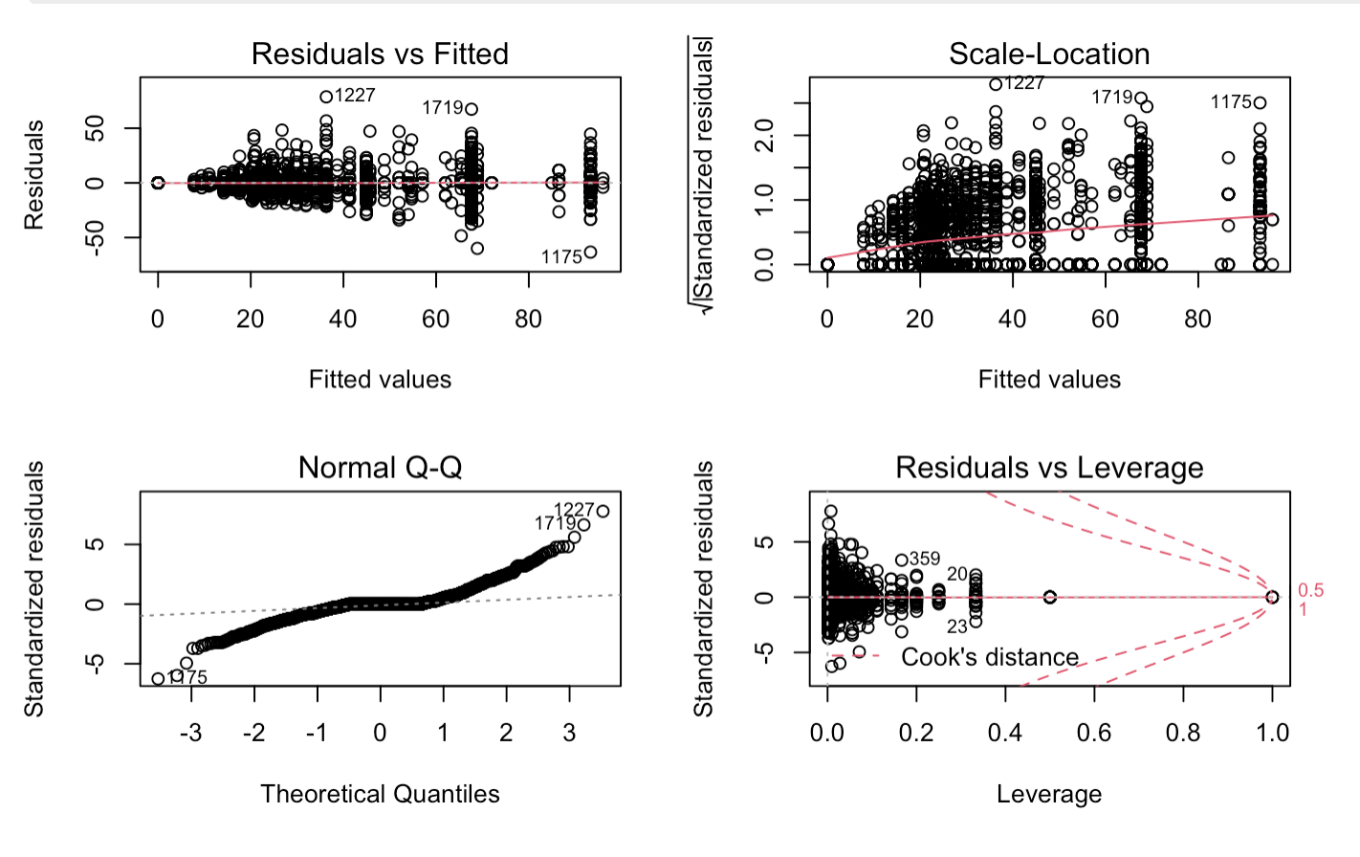
Investigating Relationship Between Style and IBU
Statistical assumptions are met, and we can generalize the model to make claims about the relationship

Slide 18
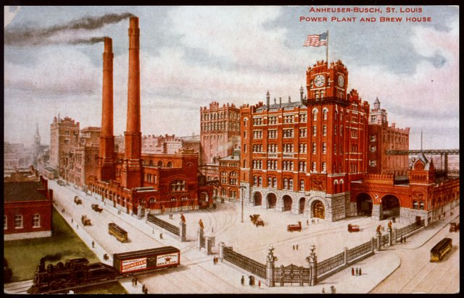
Key Takeaways
East North Central and Pacific Divisions have the Highest Number of Breweries
Highest Median ABV’s: Atlantic and Mountain Divisions
Highest Median IBU’s: South Atlantic and Mountain Divisions
Highest ABV: Colorado (Ale – 12.8)
Highest IBU: Oregon (IPA - 138)
50% of beers ABV between 5.0 – 6.7
Classification: IPA’s easy to distinguish from Ale’s (87% - kNN, 87% - Naïve Bayes)
Certain beer elements can be shown to have a statistical relationship

Slide 19
YouTube Link
https://youtu.be/N48Fv-QEUrQ

